Slide 1

Стратегии подготовки к олимпиадам по английскому языку
Межрегиональный вебинар
«СОЗДАНИЕ СРЕДЫ ДЛЯ ВОСПИТАНИЯ И РАЗВИТИЯ ТАЛАНТОВ» в рамках январского совещания работников образования Республики Саха (Якутия) “Качество образования: методические аспекты
https://docs.google.com/presentation/d/1ZacxOFkixNATDjKINwXfODfGQuRLZYYp/edit#slide=id.p1
27.01.2022
Колесников Д.П.

Slide 2
Стратегии подготовки к олимпиадам по английскому языку
Межрегиональный вебинар
«СОЗДАНИЕ СРЕДЫ ДЛЯ ВОСПИТАНИЯ И РАЗВИТИЯ ТАЛАНТОВ» в рамках январского совещания работников образования Республики Саха (Якутия) “Качество образования: методические аспекты
27.01.2022
Колесников Д.П.

Slide 3
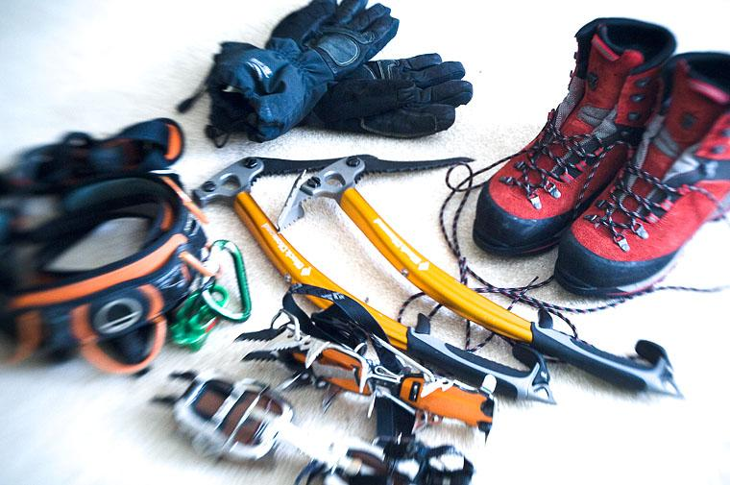
Equipment for the ascent
(inside)
Linguistic drive and curiosity
Commitment
Willpower
Persistence
Regularity

Slide 4
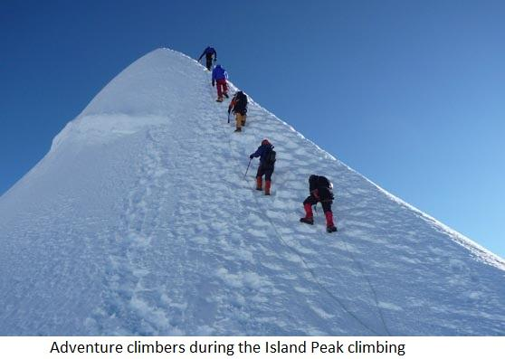
Climbing the peak

Slide 5
The Main Principle of the English Olympiad:

Slide 6
Your knowledge
Input
Output

Slide 7


Your knowledge
Input
Output
1.Grammar
2.Vocabulary
Both through:
Listening
Reading

Slide 8


Your knowledge
Input
Output
1.Grammar
2.Vocabulary
Writing
Speaking

Slide 9
Hard work on a regular basis
5 hours every day minimum (including weekends, holidays, vacations)
“day’s first hour” rule
summer – the season of the great self-work
quiet, clean workplace
have all necessary materials nearby
practice all language skills every day
think about increasing your productivity
copybooks

Slide 10

Grammar and Vocabulary
Grammar in Use by Raymond Murphy (Intermediate)
Desk self-work
Reading more
Cambridge “in Use” series
“Practice makes perfect.”

Slide 11



Writing

Slide 12
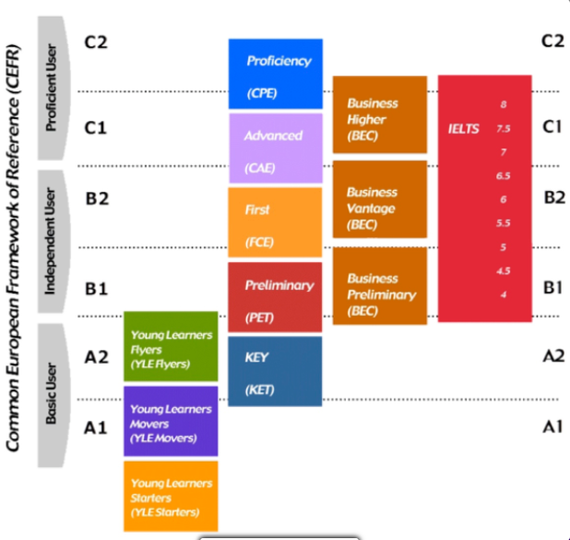

Slide 13
Топ-10 ресурсов для подготовки

Slide 14
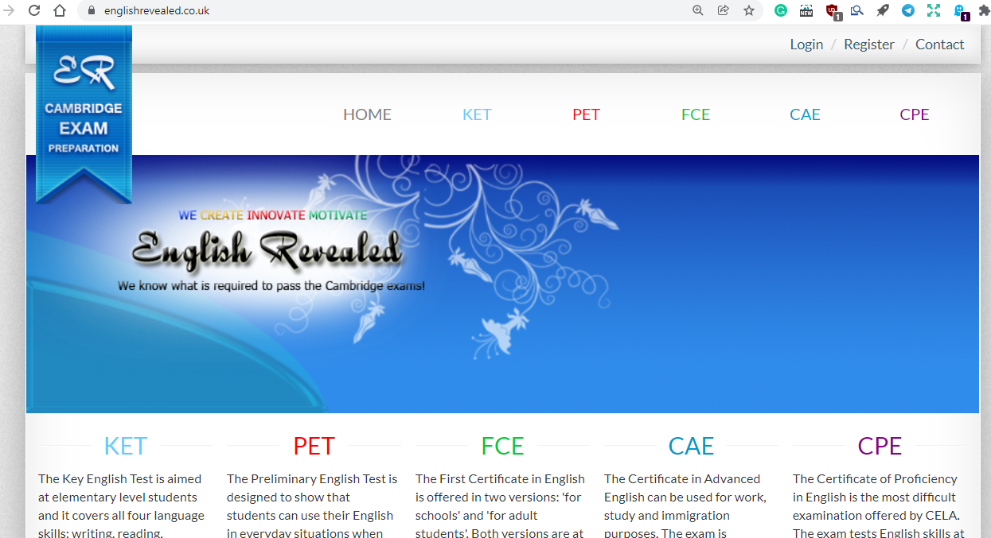
1. ENGLISHREVEALED www.englishrevealed.co.uk

Slide 15
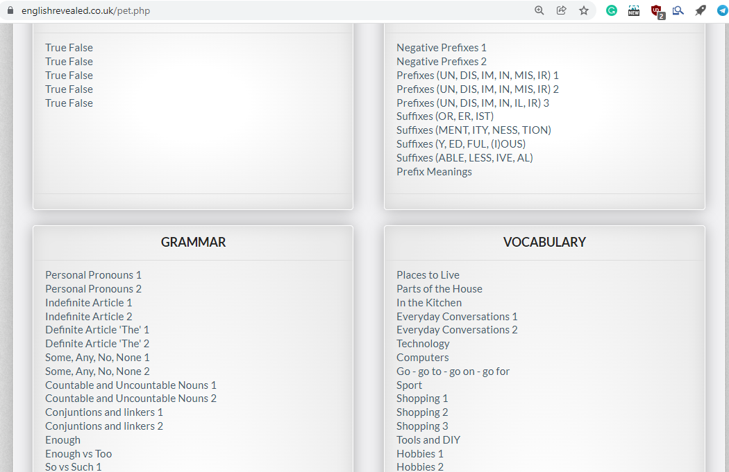
1. ENGLISHREVEALED

Slide 16
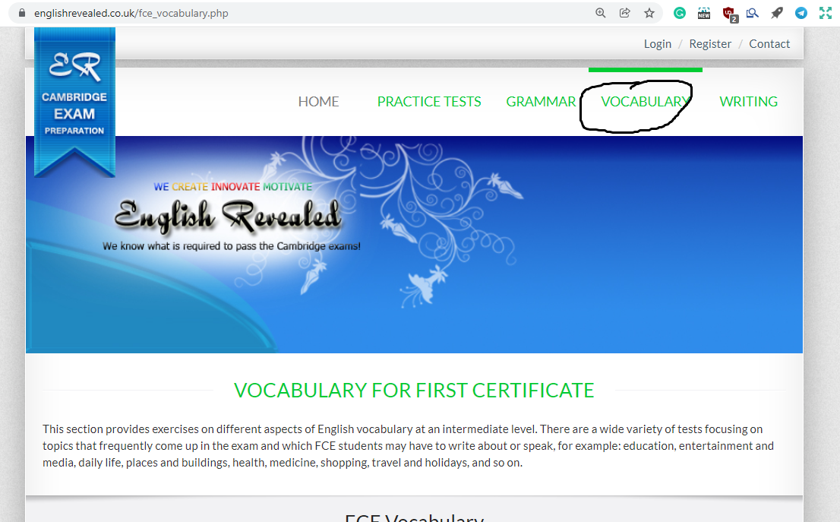
1. ENGLISHREVEALED

Slide 17
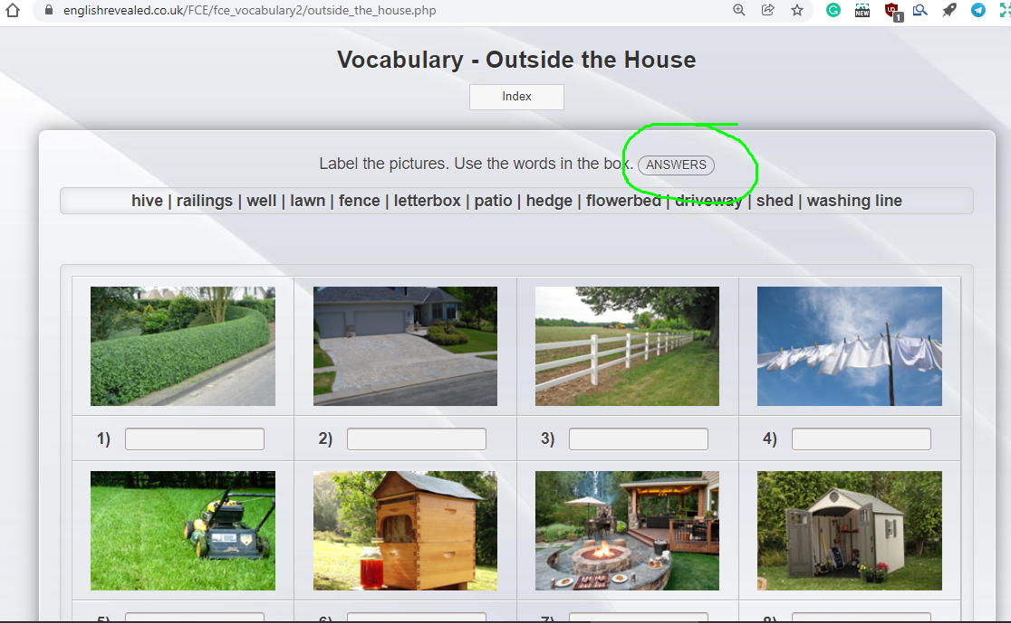
1. ENGLISHREVEALED

Slide 18
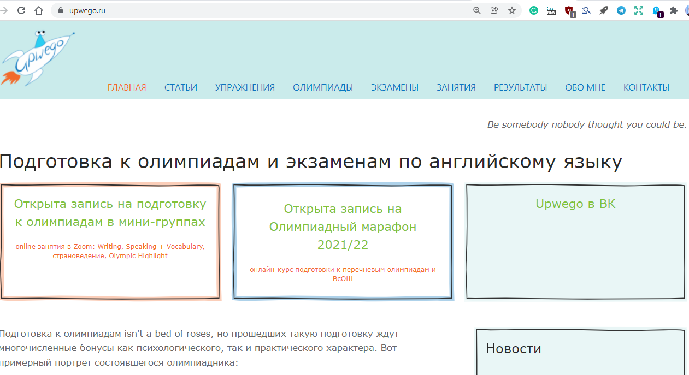
2. UPWEGO www.upwego.ru

Slide 19
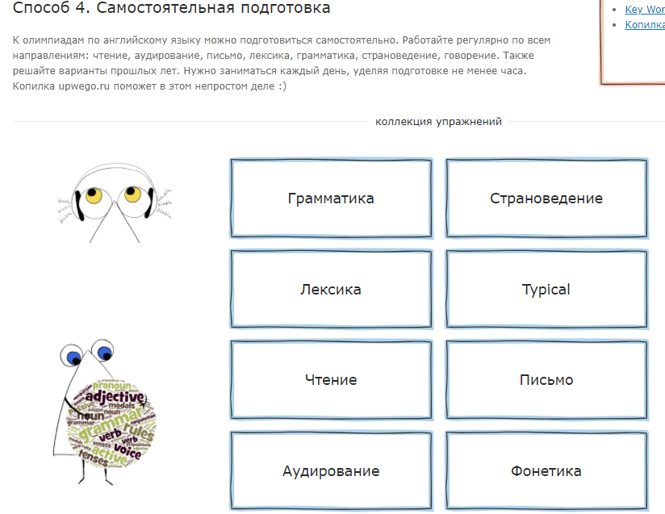
2. UPWEGO www.upwego.ru

Slide 20
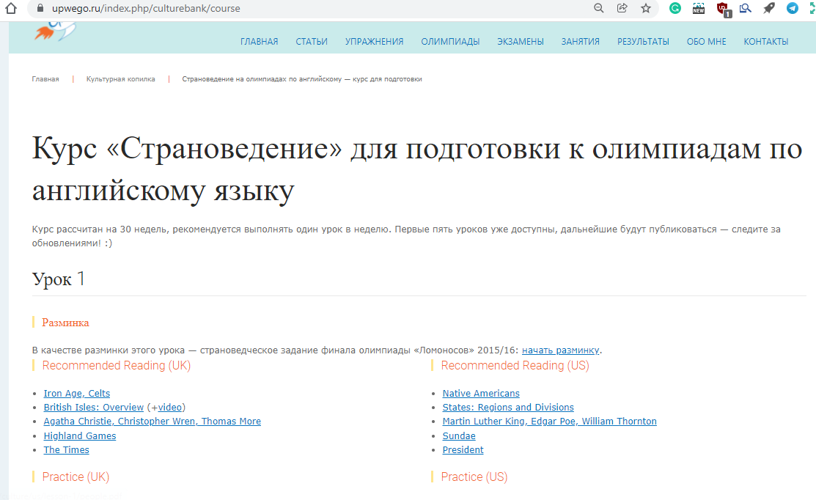
2. UPWEGO www.upwego.ru

Slide 21
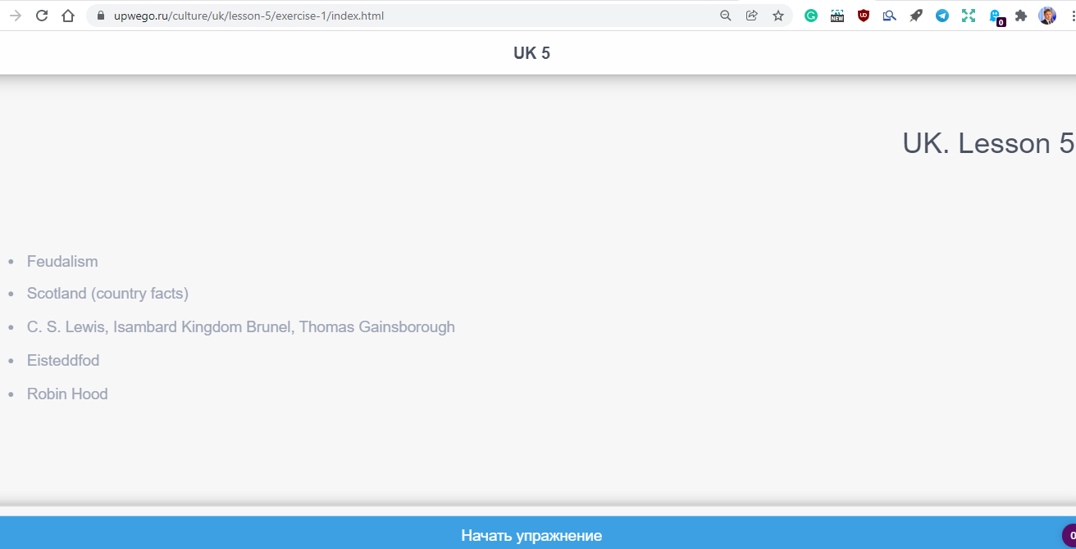
2. UPWEGO www.upwego.ru

Slide 22
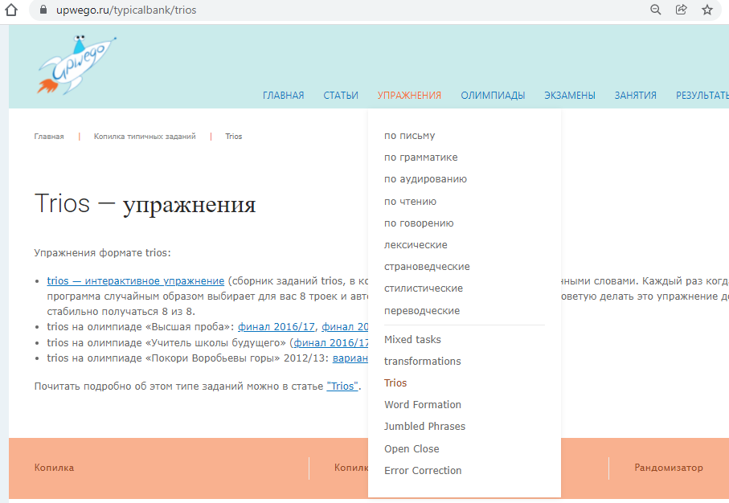
2. UPWEGO www.upwego.ru

Slide 23
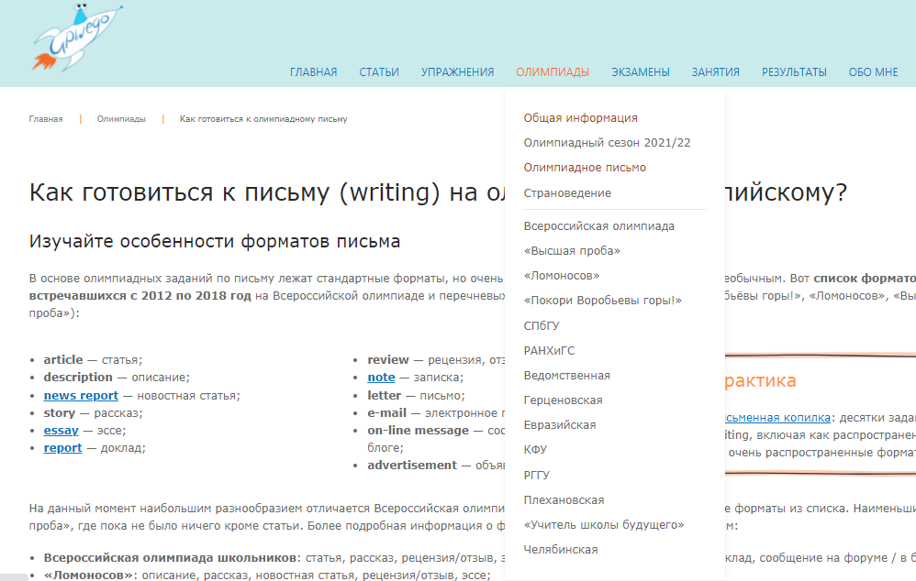
2. UPWEGO www.upwego.ru

Slide 24
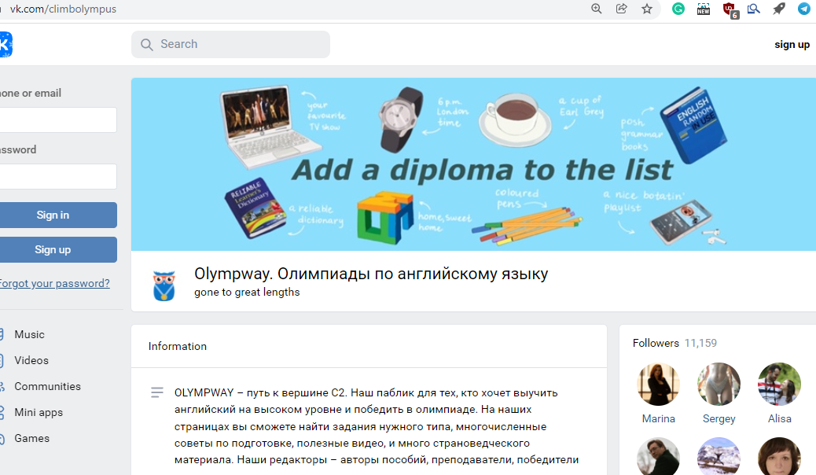
3. VK OLYMPWAY www.vk.com/climbolympus

Slide 25
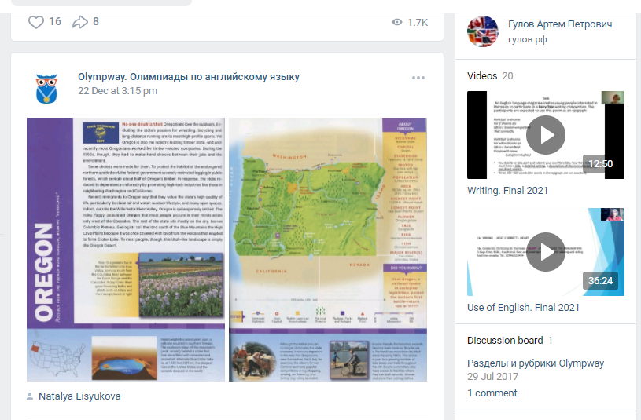
3. VK OLYMPWAY www.vk.com/climbolympus

Slide 26
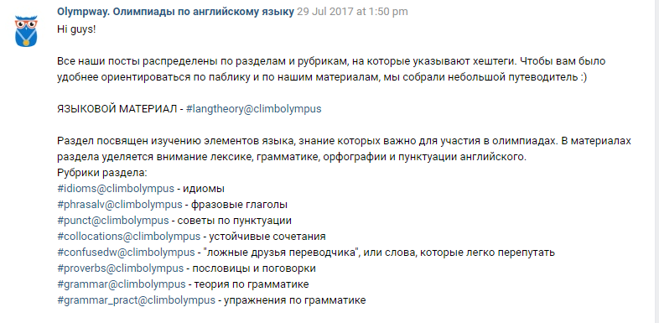
3. VK OLYMPWAY www.vk.com/climbolympus

Slide 27
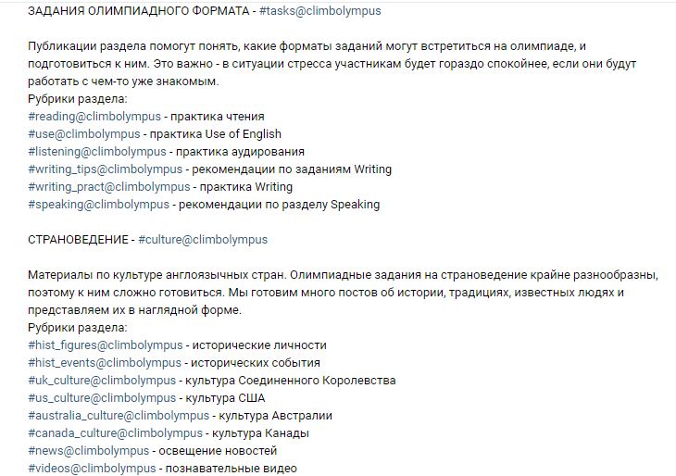
3. VK OLYMPWAY www.vk.com/climbolympus

Slide 28


4. GREAT LENGTHS & Olympiad Builder

Slide 29
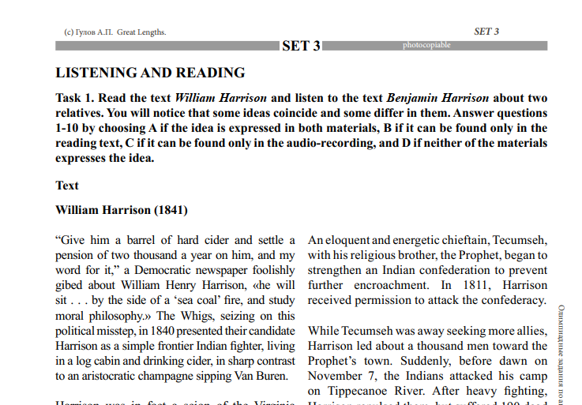
4. GREAT LENGTHS & Olympiad Builder

Slide 30
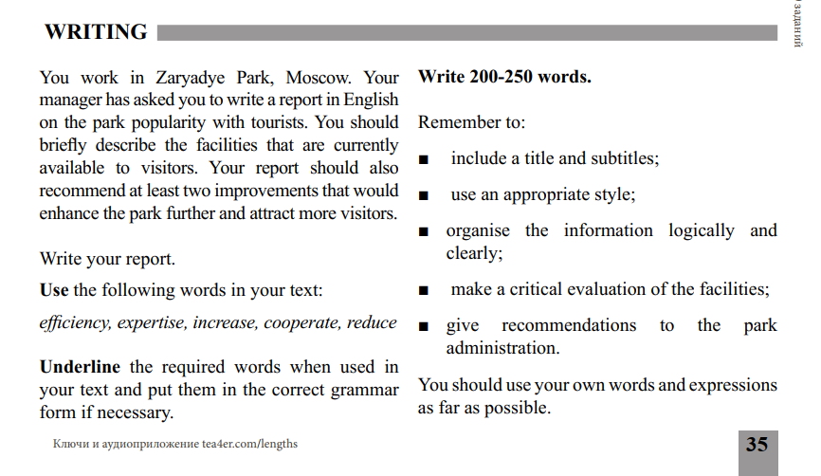
4. GREAT LENGTHS & Olympiad Builder

Slide 31
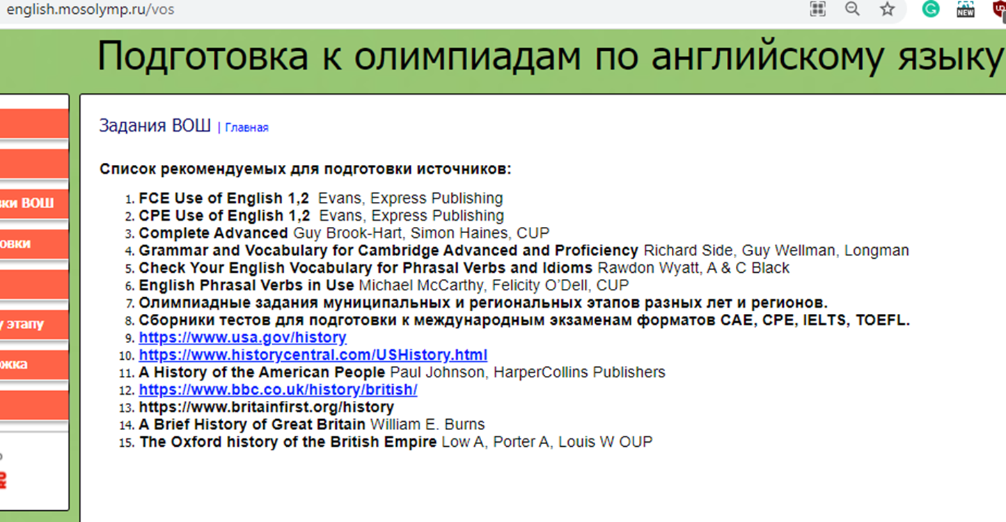
5. ENGLISH.MOSOLYMP https://english.mosolymp.ru/vos

Slide 32
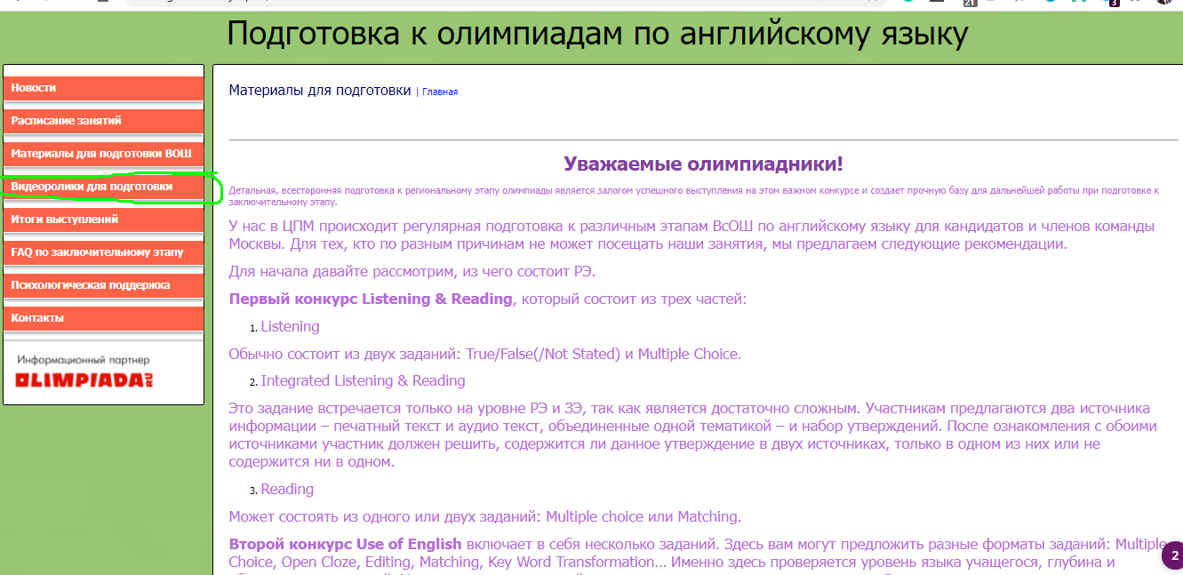
5. ENGLISH.MOSOLYMP https://english.mosolymp.ru/vos

Slide 33
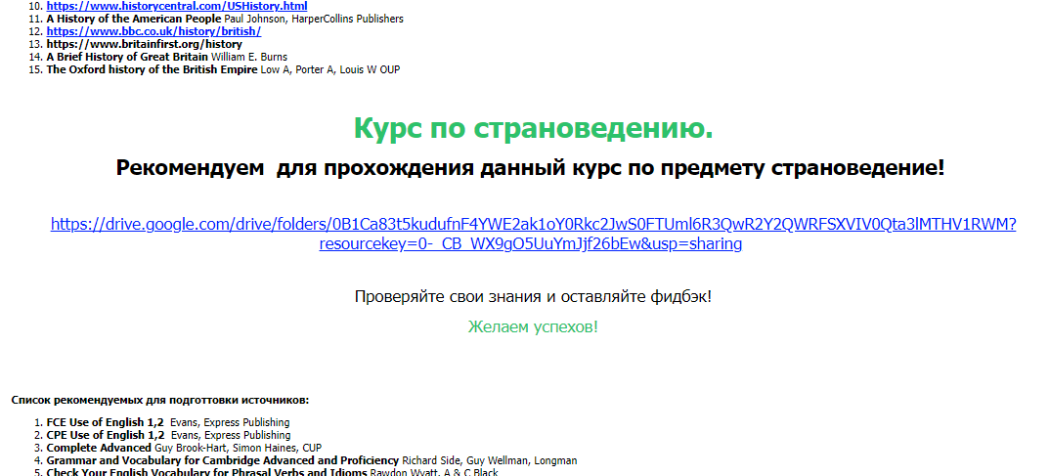
6. ENGLISH.MOSOLYMP
Курс по страноведению

Slide 34
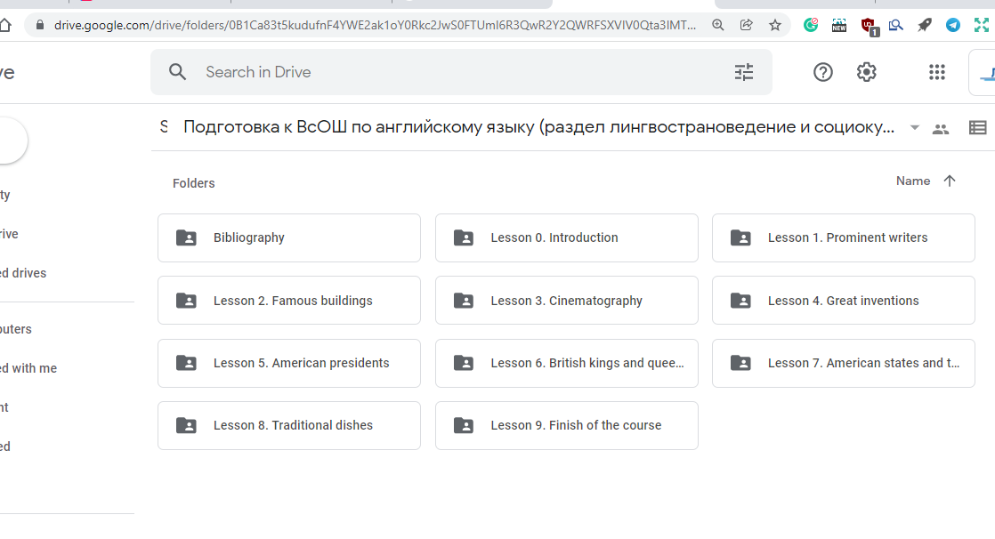
6. ENGLISH.MOSOLYMP
Курс по страноведению

Slide 35
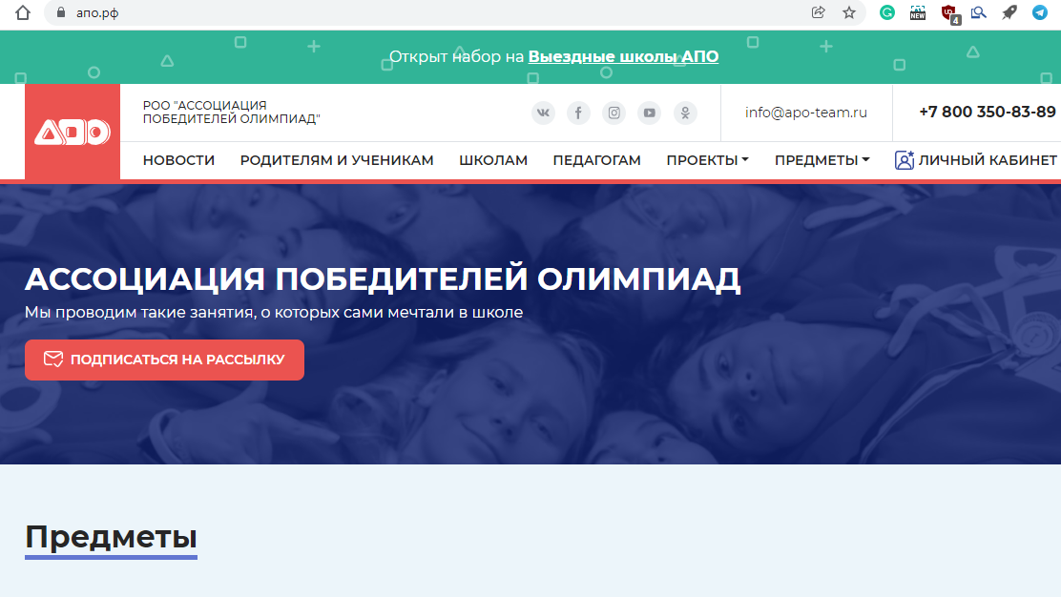
7. АПО РФ

Slide 36
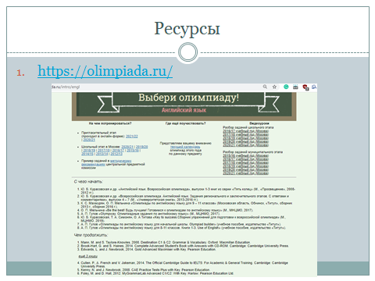
8. OLIMPIADA.RU

Slide 37
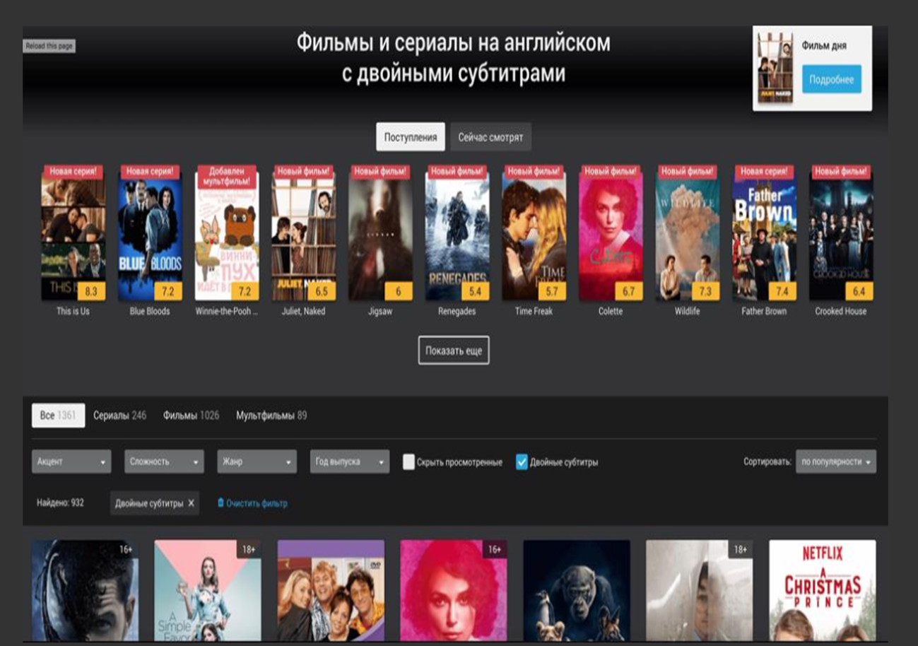
9. PUZZLE MOVIES

Slide 38
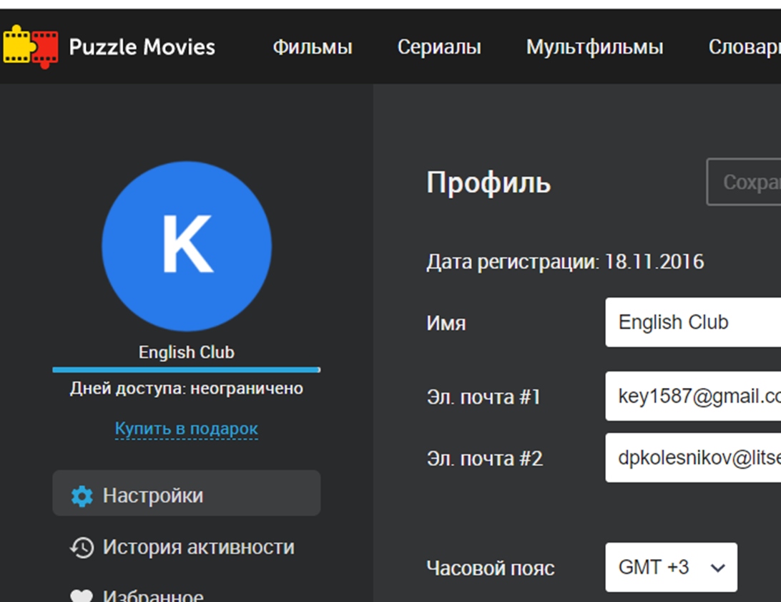
9. PUZZLE MOVIES

Slide 39
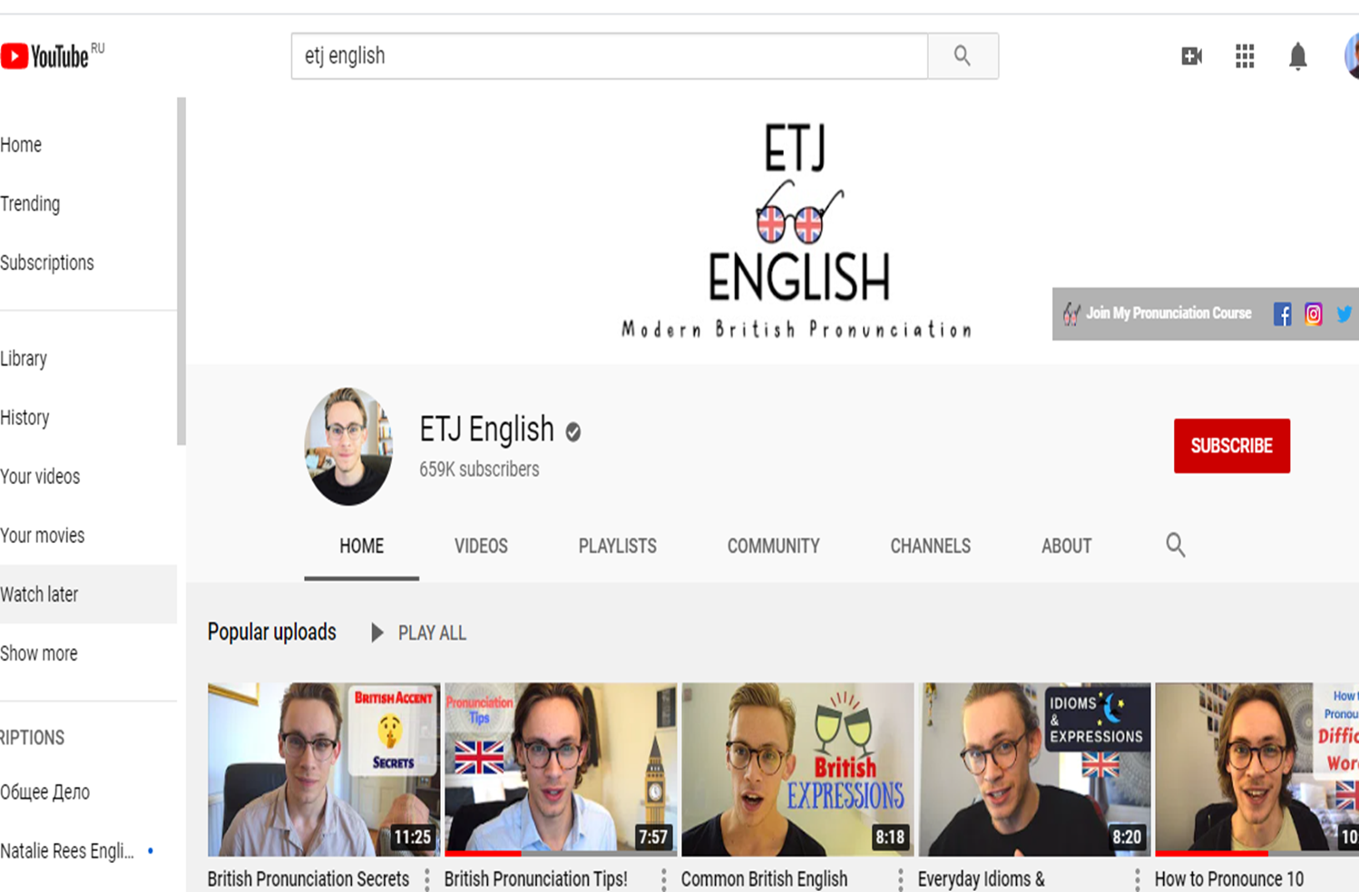
10. Rachel Am English&ETJ Br English

Slide 40
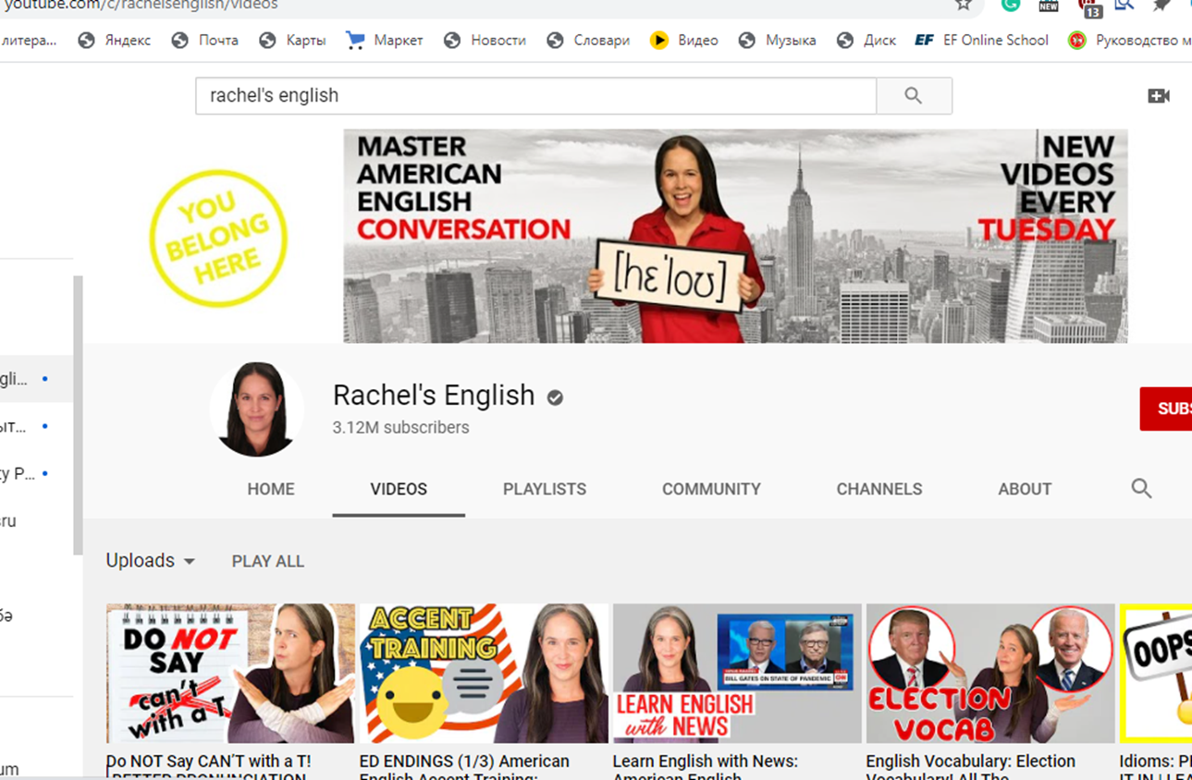
9. ETJ Br English

Slide 41
9. ETJ Br English

Slide 42
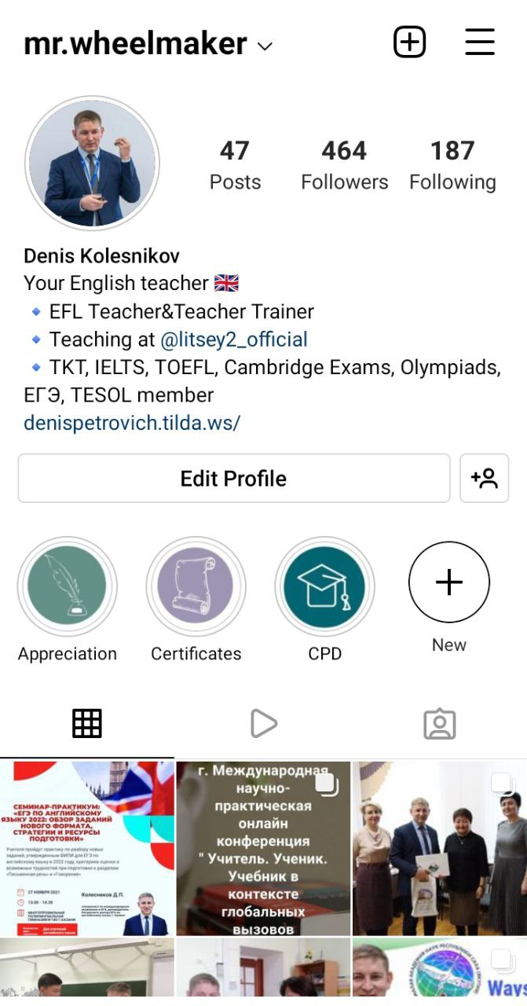
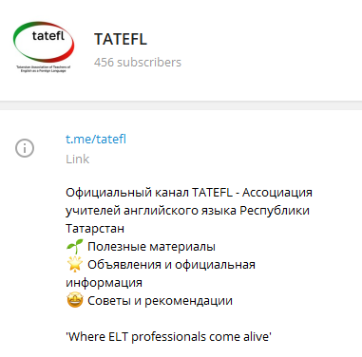
Follow me
Instagram
Telegram

Slide 43
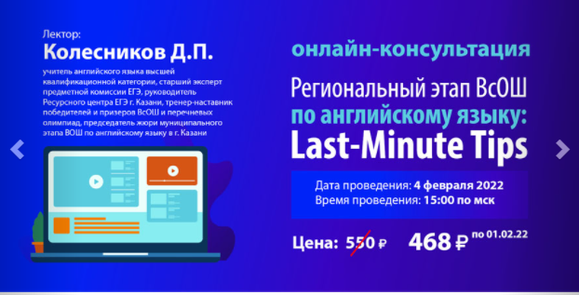
https://www.englishteachers.ru/education

Slide 44

https://www.englishteachers.ru

Slide 45


Slide 46
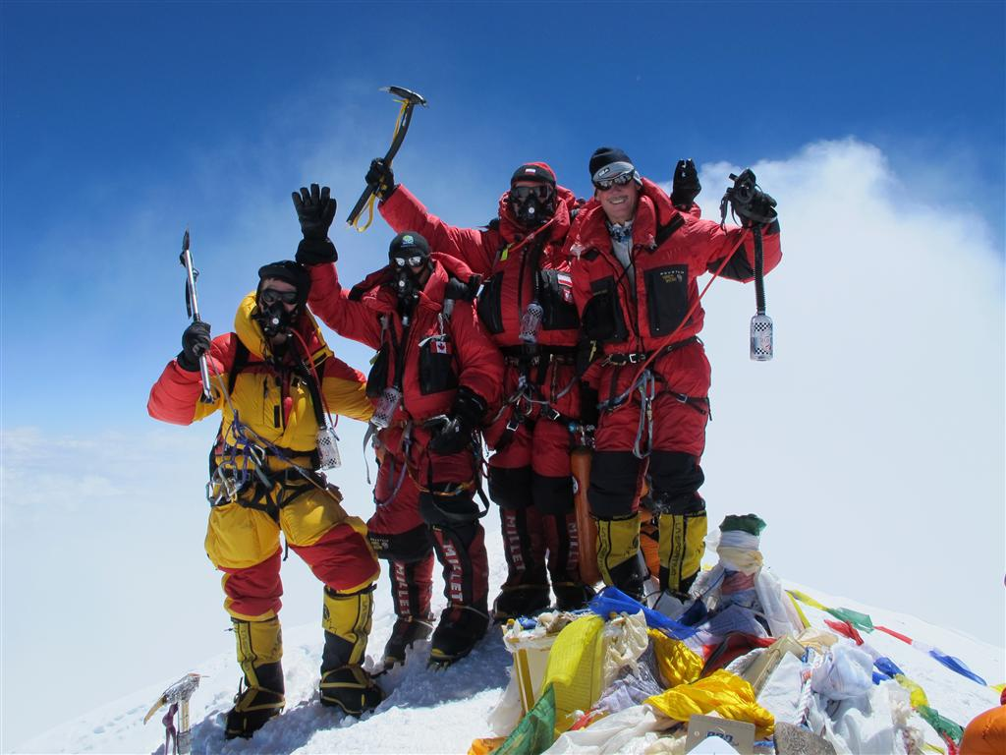
Thank you

Slide 47
Equipment for the ascent
(inside)
Linguistic drive and curiosity
Commitment
Willpower
Persistence
Regularity

Slide 48
Climbing the peak

Slide 49
The Main Principle of the English Olympiad:

Slide 50
Your knowledge
Input
Output

Slide 51
Your knowledge
Input
Output
1.Grammar
2.Vocabulary
Both through:
Listening
Reading

Slide 52
Your knowledge
Input
Output
1.Grammar
2.Vocabulary
Writing
Speaking

Slide 53
Hard work on a regular basis
5 hours every day minimum (including weekends, holidays, vacations)
“day’s first hour” rule
summer – the season of the great self-work
quiet, clean workplace
have all necessary materials nearby
practice all language skills every day
think about increasing your productivity
copybooks

Slide 54
Grammar and Vocabulary
Grammar in Use by Raymond Murphy (Intermediate)
Desk self-work
Reading more
Cambridge “in Use” series
“Practice makes perfect.”

Slide 55
Writing

Slide 57
Топ-10 ресурсов для подготовки

Slide 58
1. ENGLISHREVEALED www.englishrevealed.co.uk

Slide 59
1. ENGLISHREVEALED

Slide 60
1. ENGLISHREVEALED

Slide 61
1. ENGLISHREVEALED

Slide 62
2. UPWEGO www.upwego.ru

Slide 63
2. UPWEGO www.upwego.ru

Slide 64
2. UPWEGO www.upwego.ru

Slide 65
2. UPWEGO www.upwego.ru

Slide 66
2. UPWEGO www.upwego.ru

Slide 67
2. UPWEGO www.upwego.ru

Slide 68
3. VK OLYMPWAY www.vk.com/climbolympus

Slide 69
3. VK OLYMPWAY www.vk.com/climbolympus

Slide 70
3. VK OLYMPWAY www.vk.com/climbolympus

Slide 71
3. VK OLYMPWAY www.vk.com/climbolympus

Slide 72
4. GREAT LENGTHS & Olympiad Builder

Slide 73
4. GREAT LENGTHS & Olympiad Builder

Slide 74
4. GREAT LENGTHS & Olympiad Builder

Slide 75
5. ENGLISH.MOSOLYMP https://english.mosolymp.ru/vos

Slide 76
5. ENGLISH.MOSOLYMP https://english.mosolymp.ru/vos

Slide 77
6. ENGLISH.MOSOLYMP
Курс по страноведению

Slide 78
6. ENGLISH.MOSOLYMP
Курс по страноведению

Slide 79
7. АПО РФ

Slide 80
8. OLIMPIADA.RU

Slide 81
9. PUZZLE MOVIES

Slide 82
9. PUZZLE MOVIES

Slide 83
10. Rachel Am English&ETJ Br English

Slide 84
9. ETJ Br English

Slide 85
9. ETJ Br English

Slide 86
Follow me
Instagram
Telegram

Slide 87
https://www.englishteachers.ru/education

Slide 88
https://www.englishteachers.ru

Slide 90
Thank you

